Slide 1

React Native Development Environment Setup Guide
Welcome to our comprehensive guide on setting up a React Native development environment. This presentation will walk you through everything you need to know to get started with React Native development, from basic installations to running your first app on emulators.
Whether you're completely new to mobile development or transitioning from other platforms, this guide will help you establish a solid foundation for building cross-platform mobile applications with React Native.

Slide 2






Development Prerequisites
Node.js
React Native requires Node.js LTS version (currently 14.x+) as its JavaScript runtime environment.
NPM/Yarn
Package managers for installing and managing project dependencies.
Code Editor
Visual Studio Code, WebStorm, or Atom with React Native extensions.
Git
Version control system for tracking code changes and collaboration.

Slide 3

Node.js Installation
Download Node.js
Visit nodejs.org and download the LTS (Long Term Support) version for your operating system. React Native requires at least Node.js 12 or newer.
Run the Installer
Follow the installation wizard instructions. Make sure to check the option to install npm (Node Package Manager) which comes bundled with Node.js.
Verify Installation
Open a terminal or command prompt and run the commands "node -v" and "npm -v" to verify that both Node.js and npm were installed correctly.

Slide 4
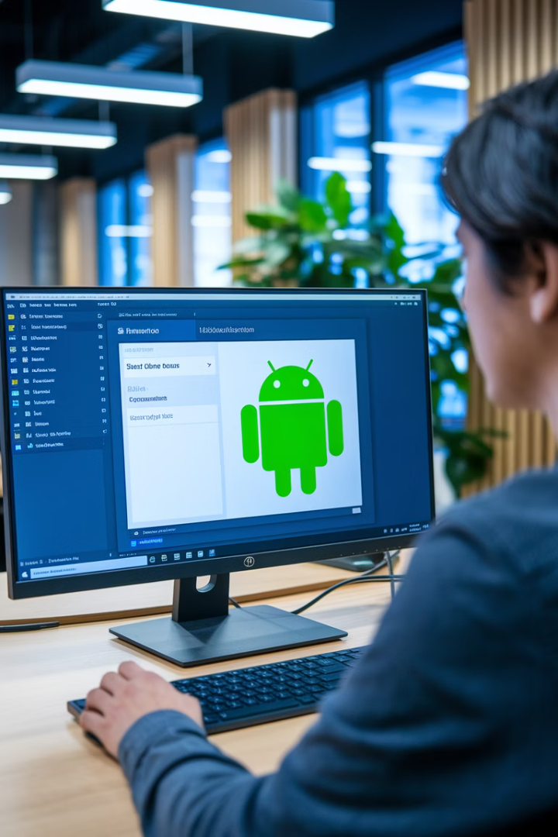




Android Studio Setup
Download Android Studio
Visit developer.android.com/studio and download the latest version of Android Studio for your operating system.
Install Android Studio
Run the installer and follow the installation wizard. Select "Custom" setup for more control over installed components.
SDK Components
During installation, ensure you check "Android SDK", "Android SDK Platform", "Android Virtual Device", and "Performance (Intel HAXM)".
Verify Installation
Open Android Studio and navigate to SDK Manager to verify installed components.

Slide 5








Android SDK Configuration
SDK Manager
Select SDK Platforms
Open Android Studio > Tools > SDK Manager or click on the SDK Manager icon in the toolbar.
Install Android 10 (Q) or higher. React Native recommends targeting recent API levels.
SDK Tools
Accept Licenses
Install "Android SDK Build-Tools", "Android Emulator", "Android SDK Platform-Tools", and "Intel x86 Emulator Accelerator".
Accept all SDK package licenses when prompted during installation.

Slide 6



Setting Up Environment Variables
Locate Android SDK
Find your Android SDK location (typically C:\Users\username\AppData\Local\Android\Sdk on Windows or /Users/username/Library/Android/sdk on macOS)
Edit Environment Variables
Access system environment variables through Control Panel (Windows) or .bash_profile/.zshrc (macOS/Linux)
Add ANDROID_HOME
Create a new variable named ANDROID_HOME pointing to your SDK location

Slide 7

Configuring PATH Variables
Operating System
Path to Add
Configuration File
Windows
%ANDROID_HOME%\platform-tools
System Properties > Environment Variables
macOS
$ANDROID_HOME/platform-tools
~/.bash_profile or ~/.zshrc
Linux
$ANDROID_HOME/platform-tools
~/.bashrc or ~/.zshrc
After configuring these variables, restart your terminal or command prompt for the changes to take effect. This ensures that Android SDK tools like adb (Android Debug Bridge) are available from your command line.
To verify your PATH configuration, open a new terminal window and type "adb --version". You should see version information for the Android Debug Bridge if everything is set up correctly.

Slide 8

Introduction to Expo
What is Expo?
Key Advantages
Expo is a framework and platform that helps you develop, build, deploy, and quickly iterate on React Native apps. It provides a set of tools and services that simplify the development process.
Expo eliminates the need to write native code or directly interact with Android Studio or Xcode, making it ideal for beginners and rapid prototyping.
Limitations
While powerful, Expo has limitations with certain native modules. Complex apps might eventually need to "eject" to the standard React Native workflow.

Slide 9





Expo CLI Installation
Install Command
Open your terminal and run: npm install -g expo-cli
Create Expo Account
Visit expo.dev to create an account, then run: expo login
Create First Project
Run: expo init MyFirstProject
Start Development Server
Navigate to project folder and run: expo start

Slide 10






Expo Go Mobile App
Install Expo Go
Download from App Store or Google Play
Scan QR Code
From Expo CLI development server
Run Your App
Preview directly on your device
The Expo Go app allows you to run your React Native projects directly on your physical device without complicated build processes. When you start your project with expo start, a QR code appears in your terminal. Scanning this code with Expo Go instantly loads your application for testing.
This approach dramatically speeds up the development cycle by allowing you to see changes in real-time as you modify your code. It's particularly useful for UI development and testing device-specific features.

Slide 11





Expo Snack: Online Development Environment
Browser-Based
Shareable
Live Preview
Save & Export
Develop React Native apps directly in your browser without any local setup.
Generate links to share your projects with others for collaboration or feedback.
See immediate results as you code with built-in iOS and Android preview panels.
Save your Snacks to your Expo account and export them as standalone projects.

Slide 12
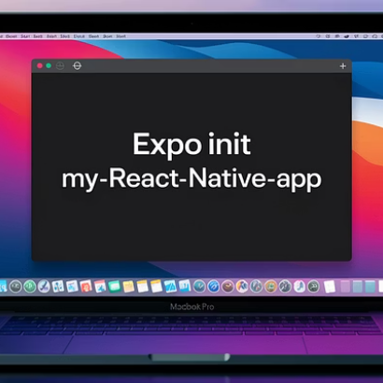
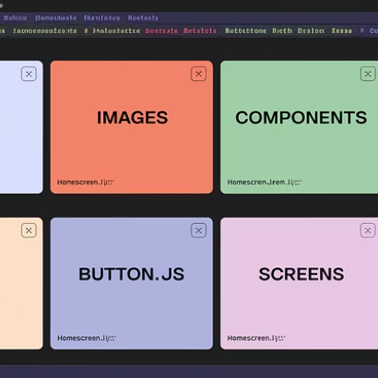
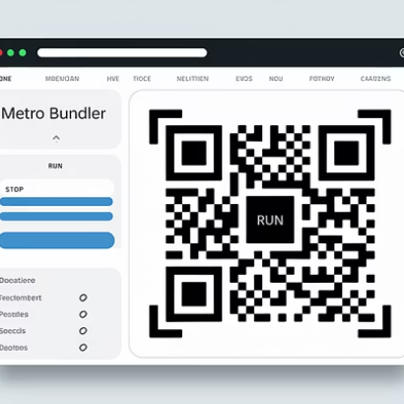

Creating Your First Expo App
Creating a new Expo app is straightforward with the Expo CLI. After installation, run "expo init YourProjectName" and follow the prompts to select a template. The "blank" template provides a minimal starting point, while "tabs" or other templates offer pre-configured navigation structures.
Once created, navigate into your project directory and run "expo start" to launch the Metro Bundler. This will open a browser window with options to run your app on various platforms and a QR code for launching on physical devices with Expo Go.

Slide 13
Understanding Emulators and Simulators
Android Emulators
iOS Simulators
Software that mimics Android devices on your development machine. They run the actual Android operating system in a virtual environment, allowing you to test your apps across different device configurations and Android versions.
Apple's simulation environment for iOS devices. Unlike emulators, simulators don't run the actual device operating system but simulate it at a higher level, making them generally faster but slightly less accurate for certain testing scenarios.
Based on QEMU virtualization
Only available on macOS
Hardware acceleration with Intel HAXM or AMD Hypervisor
Part of Xcode development suite
Fast startup and performance
Integrated with Android Studio

Slide 14
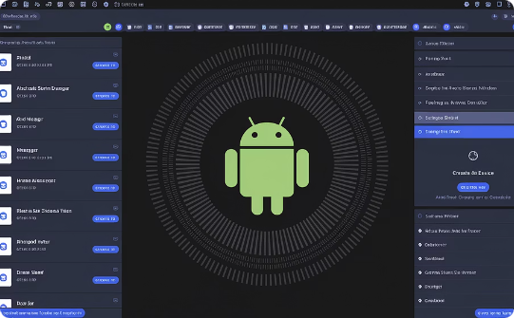
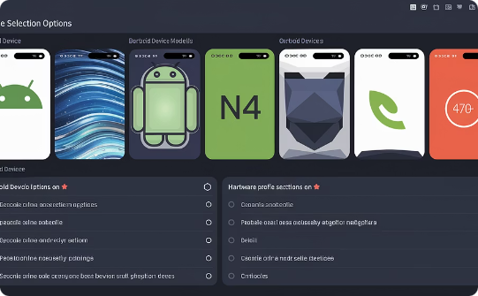

Setting Up Android Emulator
AVD Manager
Create Virtual Device
Configure & Launch
Open Android Studio and navigate to Tools > AVD Manager (Android Virtual Device Manager). This is where you create and manage your Android emulators. If you don't see it in the toolbar, you can also find it under Tools > Android > AVD Manager.
Click "Create Virtual Device" and select a device definition (like Pixel 4). Choose a system image (Android version) - preferably with Google Play services for more complete testing. Note that x86 images run much faster than ARM images on most computers.
Give your AVD a name, adjust hardware properties if needed, and click "Finish". You can now launch the emulator by clicking the play button in the AVD Manager or directly from the command line with "emulator -avd [name]".

Slide 15

Optimizing Android Emulator Performance
86%
2GB
Speed Improvement
Minimum RAM
Potential performance gain with hardware acceleration enabled
Additional RAM allocation recommended for each emulator instance
4
CPU Cores
Recommended minimum number of cores to allocate for smooth performance
To maximize Android Emulator performance, enable hardware acceleration through Intel HAXM (Windows/macOS) or KVM (Linux). You can verify if acceleration is active by checking for "HAXM is working" in emulator startup logs or running "emulator -accel-check" from command line.
Additionally, consider using snapshots to save emulator state and reduce startup times. Use a solid-state drive for your development environment, and close unnecessary background applications to free up system resources during testing.

Slide 16
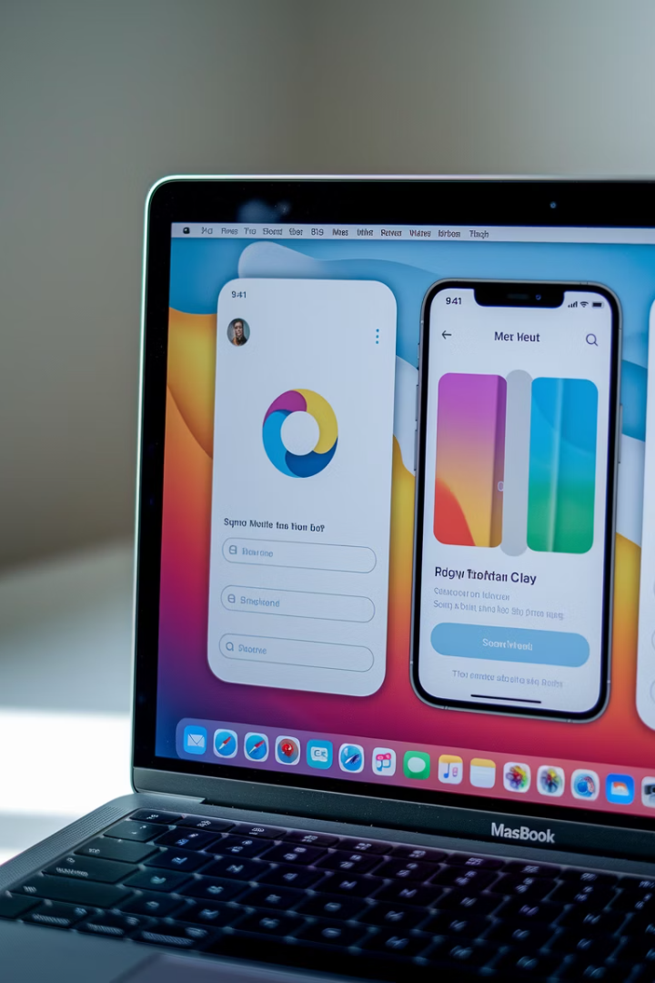
iOS Simulator Setup
The iOS simulator is exclusively available on macOS and requires Xcode, Apple's integrated development environment. To set up the iOS simulator, first download and install Xcode from the Mac App Store or the Apple Developer website.
Once Xcode is installed, open it to allow for additional components installation. You can launch the simulator directly from Xcode by going to Xcode > Open Developer Tool > Simulator, or by running "open -a Simulator" from the command line. For React Native development, you'll typically launch the simulator through the React Native CLI or Expo.

Slide 17








Managing iOS Simulator Devices
Device Types
iOS Versions
Create different iPhone and iPad models to test responsive designs
Test compatibility across multiple iOS versions
Device Features
Orientations
Simulate location, network conditions, and hardware limitations
Switch between portrait and landscape for layout testing
To add new simulator devices, open Xcode and navigate to Window > Devices and Simulators. Click the "+" button to create a new simulator, selecting the device type and iOS version. You can create multiple configurations to test your app across different screen sizes and iOS versions.
Practical simulator features include: rotating the device (⌘+left/right arrow), taking screenshots (⌘+S), simulating different network conditions, changing location for maps testing, and toggling accessibility features to ensure your app is fully accessible.

Slide 18




Troubleshooting Common Setup Issues
When setting up your React Native environment, you might encounter various issues. Common problems include incompatible versions between React Native and its dependencies, missing environment variables, or incorrect Android SDK configurations.
If you face a "command not found" error with React Native CLI, ensure it's installed globally or use npx to run it. For Android build failures, verify your ANDROID_HOME path and check that you have the correct SDK tools installed. For iOS build issues, make sure Xcode and its command-line tools are up to date.
Remember that the React Native community is active and supportive—check GitHub issues, Stack Overflow, or the React Native documentation for solutions to common problems. Most setup issues have been encountered and solved by other developers before.

Slide 19





React Native Setup: Key Takeaways
Setting up React Native requires several key steps: installing essential tools, configuring development platforms, and preparing emulators for testing. Choosing between Expo or the CLI depends on your project needs. With these components in place, you can efficiently build and test cross-platform mobile apps.
Development Prerequisites
Platform Configuration
Install Node.js, package managers, and platform-specific tools.
Set up Android SDK, Xcode, and environment variables.
Development Tools
Testing Environment
Use Expo for rapid development or CLI for native capabilities.
Configure emulators and simulators for realistic device testing.

